Slide 1
Success Criteria
Bobbie Stewart

Slide 2
Do you use success criteria in your classroom?
If so, how?
Who creates the success criteria?
What content area(s) do you use success criteria?
What benefit does success criteria have, if used, in a classroom?

Slide 3
Mentor Texts & Success Criteria: Leveled Examples
Students are given pieces that rank differently. Some of the pieces are clearly better than others.
The students have discussions and rank the pieces on which piece they think is the best.
The students have to JUSTIFY why they think one piece is better than the other!
(here lies the student created success criteria)

Slide 4
Commonly asked questions:
Why aren’t my students creating quality work?
How do I get my students to create quality work?
What does quality work look like?
What is considered quality? Not quality?

Slide 5
Having two examples of different quality side by side leads to a more explicit and deeper understanding of quality because…
Students can easily see why one example is more successful than the other and it allows students to see what excellence looks like in real terms.
Seeing what one example includes, compared to what the other example does not include, communicates excellence much more explicitly than one example which simply shows good work.

Slide 6
How do I use comparison analysis?
The younger the children, the bigger the quality gap needs to be between the two examples – otherwise, the difference are too subtle for a worthwhile comparison to take place.
The older the students, the smaller the quality gap can be.
The pieces must be anonymous.
Don’t use examples that make students feel confined to one way. If so, make a point to explain this isn’t the only way to do it. Ex.) endings, beginnings, etc.
They need to see the examples side by side.

Slide 7
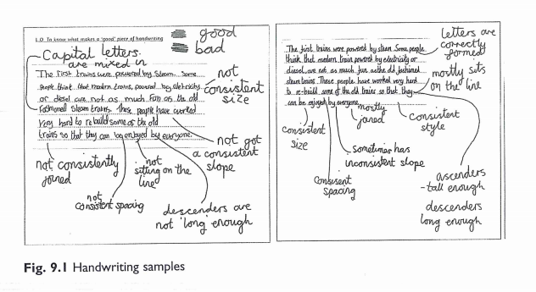
Quality, quality, quality
Having examples side by side helps students see the difference in quality work.
This leads students to produce better quality work.

Slide 8
A result of comparing 2 products:
Higher standards are promoted and expectations raised, so students produce higher quality work.
Students learn to justify their opinion.
Students are motivated to work.
Success criteria becomes embedded more quickly.
Problems are anticipated by showing them in the poorer piece.
More is being covered in less time.
Students discover the improvements that need to be made, rather than being told.
Students are inspired to be creative rather than copy.

Slide 9
Using success criteria has enabled students to have a sense of what their work should include, and, if success criteria is broken down, and include examples along the way, quality will be increased.

Slide 10
Bridging the Gap: EXPLO
Scaffolding success criteria so that students can use the success criteria

Slide 11
Using success criteria has enabled students to have a sense of what their work should include, and, if success criteria is broken down, and includes examples along the way, quality will be increased.

Slide 12
What does scaffolding mean?
Scaffolding refers to a variety of instructional techniques used to move students progressively toward stronger understanding and, ultimately, greater independence in the learning process.
The teacher provides levels of temporary support that help students reach higher levels of comprehension and skill achievement that they would not be able to achieve without assistance.
The teacher gradually shifts more responsibility of the learning process to the student.
http://edglossary.org/scaffolding/

